Slide 2
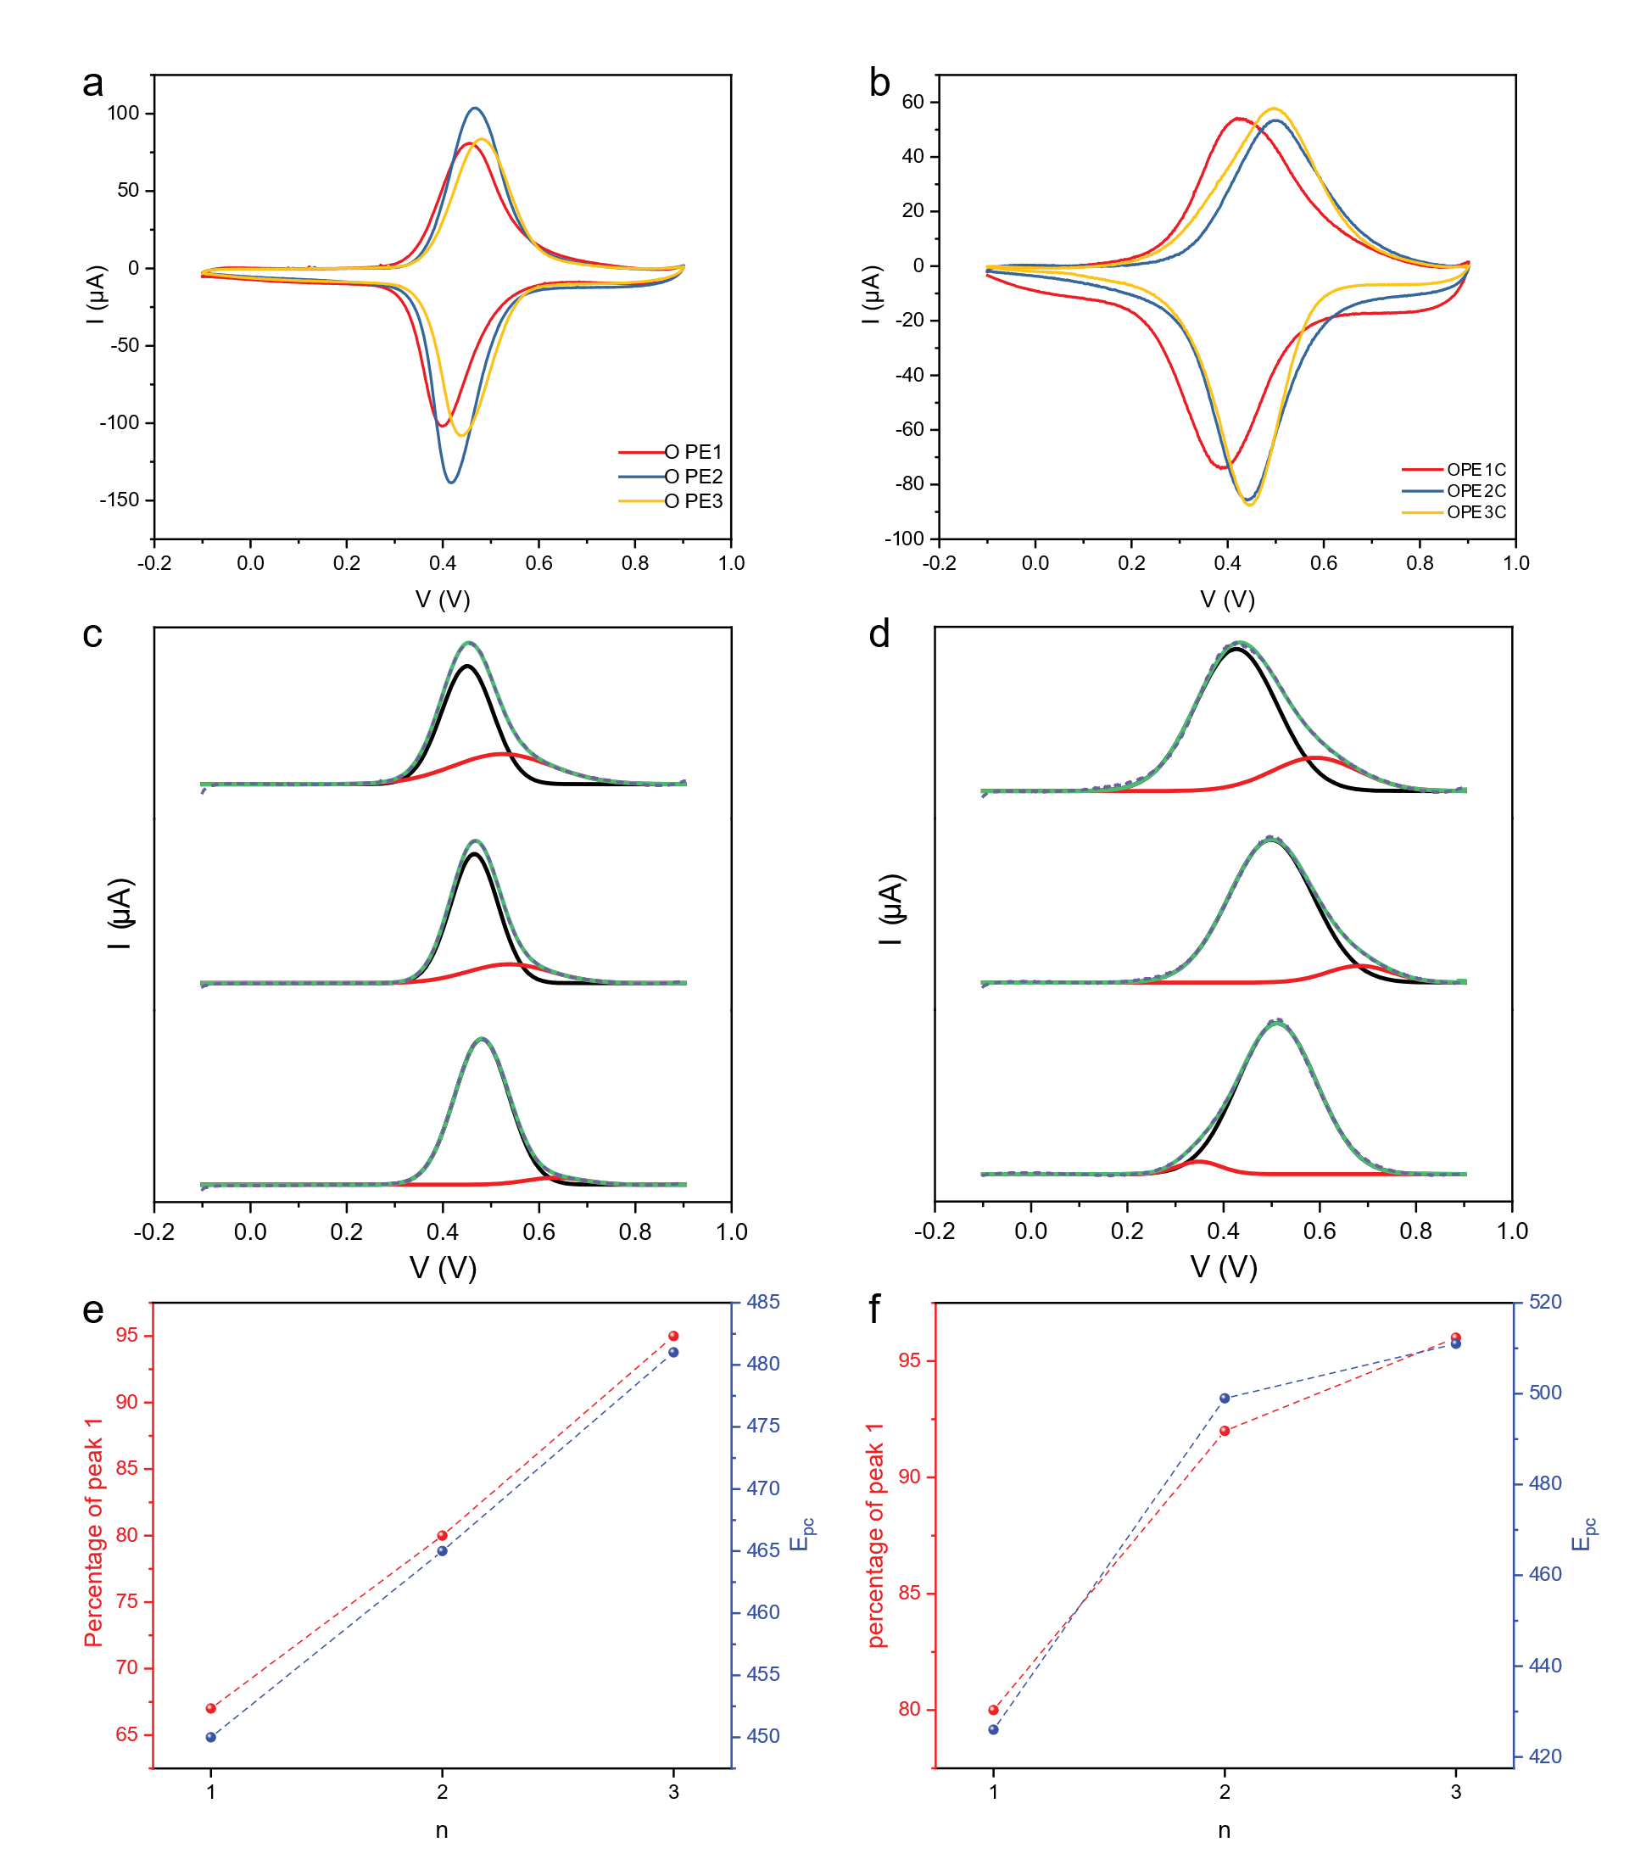
Fig 2

Slide 3
Fig 3
(a)
(b)
(c)
(d)

Slide 4
JVT – OPE1
Junction 1

Slide 5
Junction 2

Slide 6
Junction 3

Slide 7
JVT – OPE2
Junction 1

Slide 8
Junction 2

Slide 9
Junction 3

Slide 10
JVT – OPE3
Junction 1

Slide 11
Junction 2

Slide 12
Junction 3

Slide 13
JVT – OPE1C
Junction 1

Slide 14
Junction 2

Slide 15
Junction 3

Slide 16
JVT – OPE2C
Junction 1

Slide 17
Junction 2

Slide 18
Junction 3

Slide 19
JVT – OPE3C
Junction 1

Slide 20
Junction 2

Slide 21
Junction 3

Slide 22
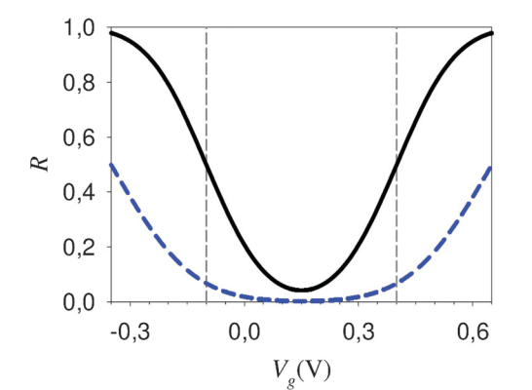
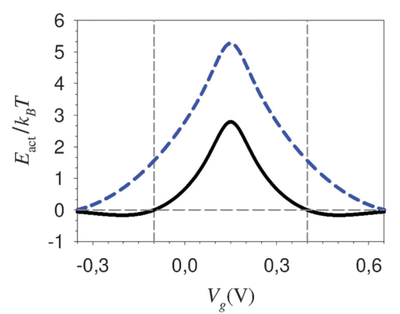
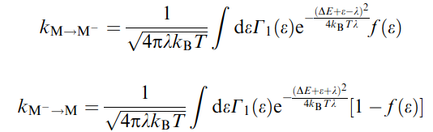
-1 V
-1 V
n = 3
n = 3
n = 2
0 V
n = 2
0 V
n = 1
n = 1
Au
n = 1
EGaIn
Au
n = 1
EGaIn
n = 2
n = 2
n = 3
+1 V
n = 3
+1 V
n = 1
n = 1
n = 2
n = 2
n = 3
Γ_{top}
n = 3
Γ_{bottom}
Γ_{bottom}
Γ_{top}
OPEn
OPEnC
In Nitzan’s work, ε is the same for both electrodes (zero bias system)
In our case, ε is different for the top and bottom electrodes, would the bell-curve stay the same?
The “peak” represent the point where K_{M→M-} = K_{M-→M} in zero bias system, what does it represent here?

Slide 23
OPE1
OPE2
OPE3
OPE1C
OPE2C
OPE3C
-1.97 eV
-2.10 eV
-1.94 eV
-2.16 eV
-2.11 eV
-2.18 eV
~-4.4 eV
-5.10 eV
-5.10 eV
EGaIn
-4.3 eV
Au
-5.15 eV
-5.17 eV
-5.14 eV
-5.17 eV

Slide 24
a
b
LUMO
OPE
Normal Marcus
OPE2, OPE3
LUMO
OPE
-1 V
Inverted Marcus
OPE2C, OPE3C
EGaIn
HOMO
Fc
Au
+1 V
Au
EGaIn
HOMO
Fc

Slide 25
-1 V
Fc
-1 V
Fc
EGaIn
EGaIn
Fc⁺
Au
Fc⁺
Au
OPE3
OPE3C
Normal Marcus
Inverted Marcus

Slide 27
XPS
S 2p of OPEn on Au surface

Slide 28
S 2p of OPEnC on Au surface

Slide 29
S 2p of OPEnC on Ag surface

Slide 30
S 2p of OPEnC on Pt surface

Slide 31
-1 V
-1 V
n = 3
n = 3
n = 2
n = 2
n = 1
0 V
n = 1
0 V
Au
n = 1
EGaIn
Au
n = 1
EGaIn
n = 2
n = 2
n = 3
n = 3
n = 1
+1 V
n = 1
+1 V
n = 2
n = 2
n = 3
n = 3
OPEn
OPEnC

Slide 32
(a)
(b)
(c)

Slide 33
NEXAFS
NEXAFS of OPEn on Au
Close up on the p* region. With the help of the PDOS calculation we are able to determine the peak assignment.
The first p* peak represent the LUMO of the molecule, which mostly consist of the p* of the aromatic OPE backbone. The second peak, denoting LUMO + 1, has both contributions from the Fe and C, makes it more likely to be Fe 3d orbital hybridized with the p* of the cyclopentadiene.

Slide 35
CV of Fc-(C≡C-Ph)_{n}-SH (n=1-3)
Molecule | Γ(10⁻¹⁰ mol/cm²) | Epa(mV) | Epc(mV) | ΔE(mV) | Ipa/Ipc | FWHM-Epa(mV) | FWHM-Epc(mV) | EHOMO(eV)
Fc-(C=C-Ph)₁-SH | 3.47 ± 0.13 | 452 ± 10 | 398 ± 9 | 29 ± 1 | 0.87 ± 0.01 | 140 ± 5 | 115 ± 1 | -5.122 ± 0.006
Fc-(C=C-Ph)₂-SH | 3.86 ± 0.08 | 461 ± 9 | 414 ± 10 | 55 ± 2 | 0.80 ± 0.01 | 123 ± 1 | 111 ± 1 | -5.134 ± 0.007
Fc-(C=C-Ph)₃-SH | 3.40 ± 0.11 | 484 ± 6 | 445 ± 10 | 53 ± 4 | 0.83 ± 0.04 | 137 ± 2 | 116 ± 3 | -5.161 ± 0.006

Slide 36
CV of Fc-(C≡C-Ph)_{n}-CH₂-SH (n=1-3)
Molecule | Γ(10⁻¹⁰ mol/cm²) | Epa(mV) | Epc(mV) | ΔE(mV) | Ipa/Ipc | FWHM-Epa(mV) | FWHM-Epc(mV) | EHOMO(eV)
Fc-(C=C-Ph)₁-CH₂-SH | 3.59 ± 0.21 | 421 ± 6 | 393 ± 6 | 29 ± 2 | 0.85 ± 0.05 | 218 ± 10 | 186 ± 5 | -5.104 ± 0.006
Fc-(C=C-Ph)₂-CH₂-SH | 3.41 ± 0.14 | 499 ± 5 | 444 ± 3 | 55 ± 2 | 0.71 ± 0.01 | 207 ± 6 | 167 ± 5 | -5.169 ± 0.004
Fc-(C=C-Ph)₃-CH₂-SH | 3.65 ± 0.12 | 504 ± 5 | 451 ± 11 | 53 ± 7 | 0.68 ± 0.01 | 217 ± 14 | 148 ± 6 | -5.174 ± 0.008

Slide 38
The distance is calculated from CPK model and the tile angle from NEXAFS.

Slide 39
J-V curves of Fc-(C=C-Ph)_{n}-CH₂-SH (n=1-3)
Fc-(C=C-Ph)₁-CH₂-SH
20 junctions, 440 traces

Slide 40
Fc-(C=C-Ph)₂-CH₂-SH
Histogram at +1V and – 1V.
Just from these two it looks like they will have a small beta and similar rectification of about 1.5 order. I will measure Fc-(C=C-Ph)₁-CH₂-SH next week and we should be able to make some conclusions.
22 junctions, 440 traces.

Slide 41
Fc-(C=C-Ph)₃-CH₂-SH
Histogram at + and – 1V.
20 junctions, 400 traces. The error bar is log standard deviation.

Slide 42
The curves converges at – 1V and shows clear decay in + 1 V. This is the same trend Jiang Li observed in the OPE series without the extra CH₂. It is likely that charge transports by hopping in -1V and tunnelling in +1V.
The thermal glue problem needs to be fixed before the OPE series get measured. So I’ll help Nipun on that. Meanwhile I can work on the deuterated project and low-T.

Slide 43
JV and histograms for each junctions
Fc-(C≡C-Ph)₁-SH
-1V
+1V

Slide 44
Fc-(C≡C-Ph)₂-SH
-1V
+1V

Slide 45
Fc-(C≡C-Ph)₃-SH
-1V
+1V

Slide 46
Fc-(C≡C-Ph)₁-CH₂-SH
-1V
+1V

Slide 47
Fc-(C≡C-Ph)₂-CH₂-SH
-1V
+1V

Slide 48
Fc-(C≡C-Ph)₃-CH₂-SH
-1V
+1V

Slide 49
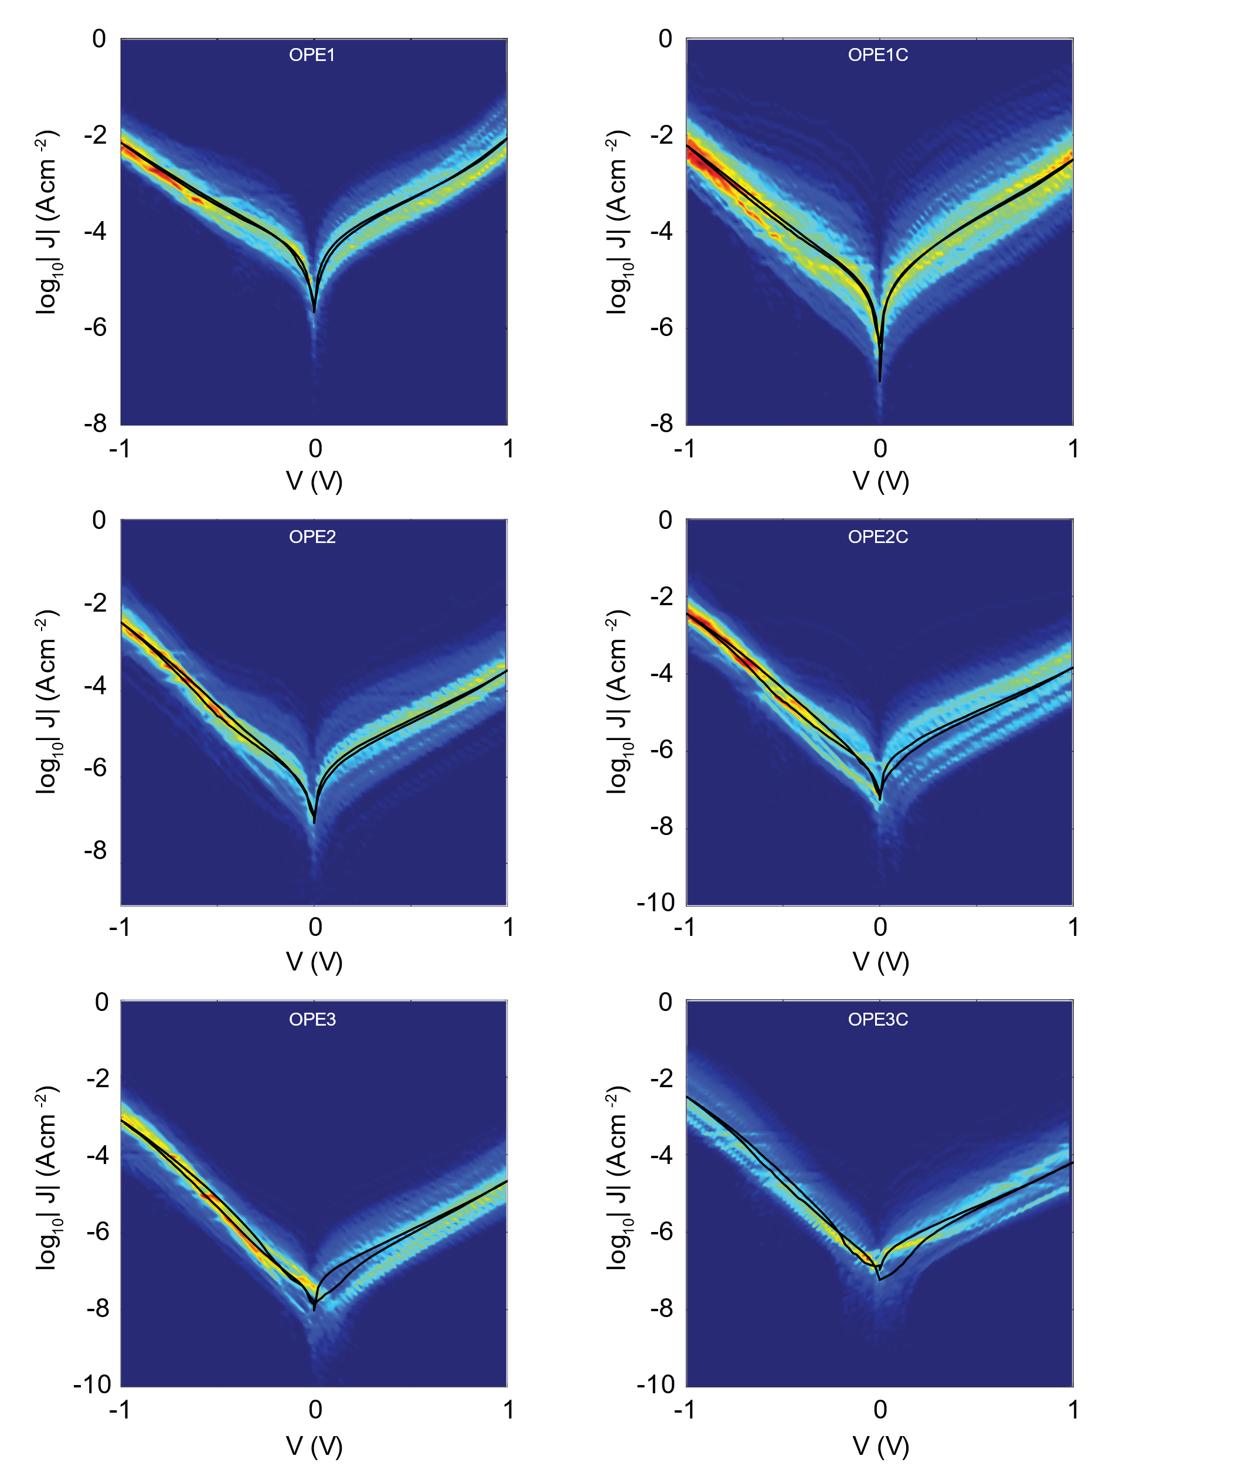
Heatmaps

Slide 51
Impedance Measurement
Fc-(C≡C-Ph)₁-SH
Residue plot - fitting
Residue plot - KK

Slide 52
Fc-(C≡C-Ph)₂-SH
Residue plot - fitting
Residue plot - KK

Slide 53
Molecule | R_{SAM} (Ω·cm²) | C_{SAM} (μF/cm²) | Rs ( ×10⁻⁴ Ω·cm²)
OPE1 | 2490 ± 1 | 4.18 ± 0.04 | 9.01 ± 7.42
OPE2 | 726 ± 2 | 3.87 ± 0.03 | 12.5 ± 4.59

